Slide 1


THE EAGLE TRAIL What Is It? How Do You Get There?

Slide 2
What Is the Eagle Trail?
The Eagle Trail is a roadmap to becoming an Eagle Scout
It includes Scout, Tenderfoot, Second Class, First Class, Star, Life and Eagle Scout
It is a 4-6 year commitment by both the Scout and his family
The end result is a young adult with valuable lifetime skills

Slide 3
How Do I Become An Eagle Scout?
You begin with fundamental Scouting skills via Scout, Tenderfoot, Second Class and First Class
You then develop advanced Scouting skills via merit badges, troop leadership positions and community service projects
You finish the Eagle Trail by completing 21 merit badges (13 Eagle Badges required) and a large community service project

Slide 4
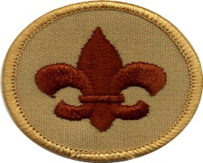
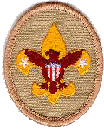
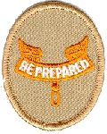


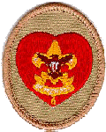
Possible Pathway
Note: this represents a possible pathway. There is no implied requirement to complete Ranks in the years denoted.
New Scout Patrol
Patrol Member
Patrol Leader
Sr. Leaders
Jr. ASM’s
1st Year
2nd Year
3rd Year
4th+ Year
Age: 11-12
Age: 12 -13
Age: 13 -14
Age: 15+

Slide 5
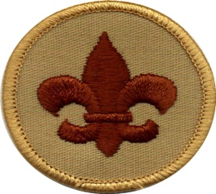
Scout Requirements
KNOWLEDGE
Scout Oath
Scout Law
Scout Motto
Scout Slogan
Knots
Knife Safety
Scout Process
Leadership in Troop
Steps of Advancement
Ranks
Patrol Method
Scoutmaster Conference
Board of Review

Slide 6
Tenderfoot Requirements
KNOWLEDGE
Camping & Outdoor Ethics
First Aid
Hiking Safety
Scout Slogan, etc.
Scoutmaster conference
Board of Review
SKILLS
One campout, includes cooking.
Basic knots
Flag protocol
Physical fitness
Service

Slide 7
Second Class Requirements
EXPERIENCE
5 troop activities, including 3 Camping Trips
Flag ceremony
Service project
Drugs and Alcohol Dangers.
Personal Fitness
Scoutmaster conference
Board of Review
SKILLS
Cooking
Knots
Navigation
Wild animals
First Aid & Emergency Preparedness
Swimming
Money Management

Slide 8
First Class Requirements
EXPERIENCE
10 troop activities, including six overnight camping trips.
Service project(s)
Internet safety
Personal Fitness
Recruiting a new Scout
Scoutmaster conference
Board of Review
SKILLS
Cooking
Knots
Navigation
Native plants
Weather & Hazards
Swimming (BSA Swim Test)
First Aid/Emergency Preparedness

Slide 9
Star Requirements
6 merit badges including 4 Eagle badges
6 hours of Service Projects
Troop Leadership for 4 months
Protect Child from Child Abuse & Cyber Chip Award
Scoutmaster Conference
Board of Review

Slide 10
Life Requirements
11 merit badges including 7 Eagle Badges
6 hours of Service Projects
Troop Leadership for 6 months
Mentor Younger Scouts using the EDGE Method
Scoutmaster Conference
Board of Review

Slide 11
Eagle Requirements
21 merit badges including 13 Eagle badges
Troop Leadership for 6 months
Eagle Project (100+ hours) - Leadership
Project approved by Scout Council
Must include other Scouts
Project write up
Eagle Board of Review

Slide 12
What Does It Take To Become An Eagle Scout?
Individual Commitment (Parents only in a supportive role)
Participation in troop activities
Leadership Role
Community Service
Teamwork and Mentoring

Slide 13
What Are the Benefits of Being An Eagle Scout?
Once An Eagle Scout, Always An Eagle Scout
Skills
Leadership
Community Service
Survival Skills
Personal Management and Family Life
Citizenship

Slide 14
What Are the Benefits of An Eagle Scout?
Experiences
Camping, Hiking, Rafting, Skiing, Fishing, Cooking
Volunteer activities and service projects
Your Most Important Achievement as a Young Adult
Credentials
College applications
Job resumes
A certified Outdoorsman and Scout Citizen
wongj

Slide 15
References
Merit Badge Overview
http://www.scouting.org/scoutsource/BoyScouts/AdvancementandAwards/MeritBadges.aspx
Merit Badge Worksheets
http://www.meritbadge.org/wiki/index.php/Merit_Badges
BSA Advancement Guide
http://www.scouting.org/filestore/pdf/33088.pdf
http://www.scouting.org/scoutsource/BoyScouts/AdvancementandAwards.aspx

